Slide 1
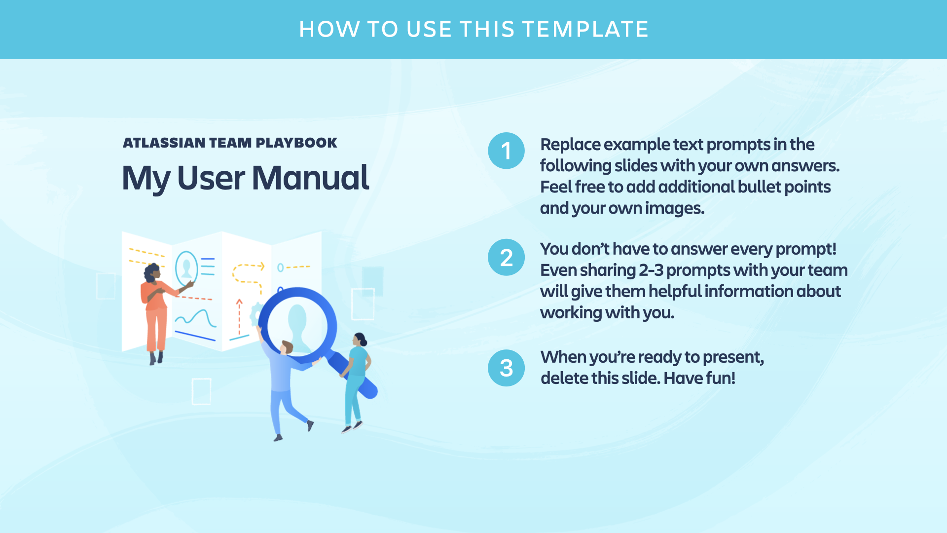

Slide 2
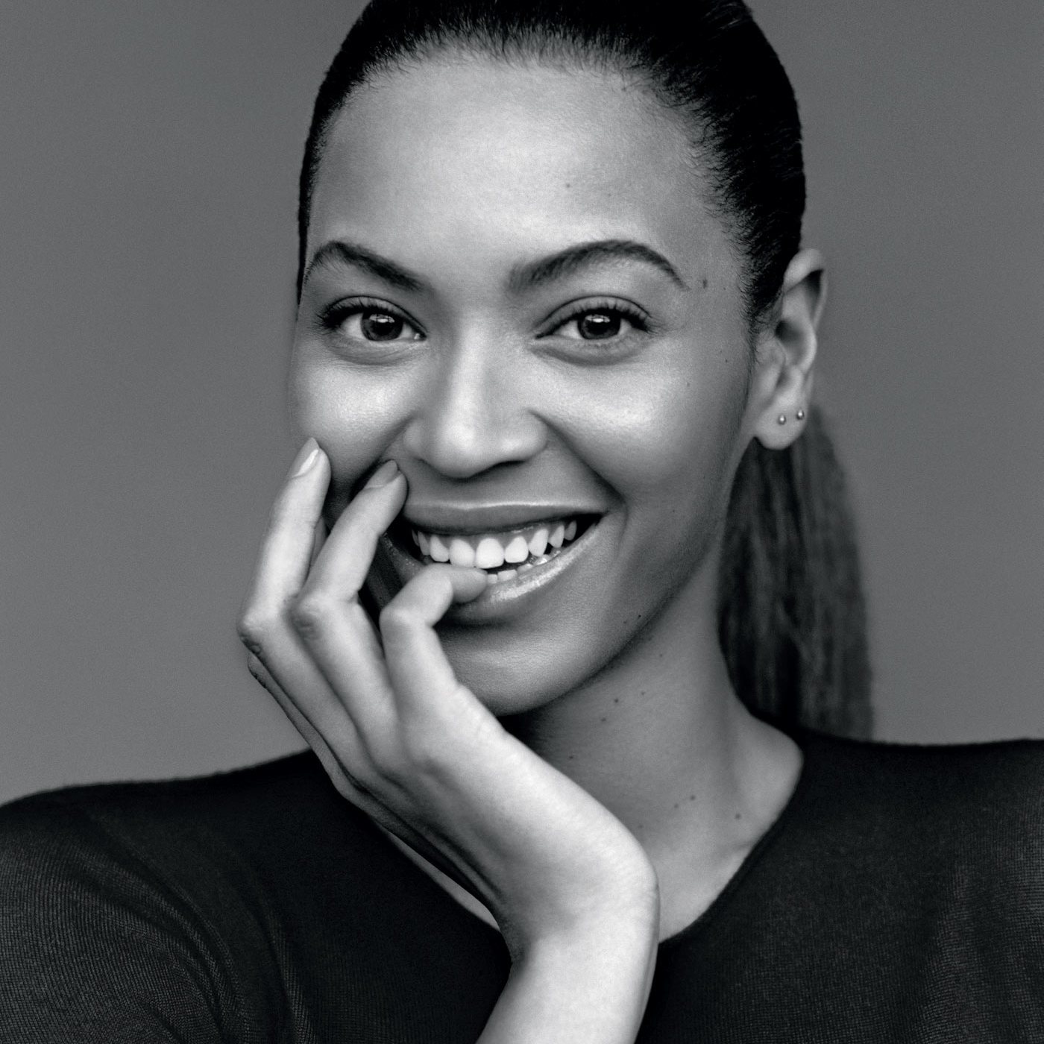
Company name / logo
[Name]’s User Manual
Optional Subtitle
title | date

Slide 3
Conditions I like to work in
Bullet point
[Example: I like a quiet working environment. I find it hard to do work that requires my concentration if there is a lot of noise and distractions.]
Bullet point
[Example: I like having my own desk space]
Bullet point
[Example: If I have my headphones on, I am in focus mode, so please do not disturb me!]
[OPTIONAL IMAGE / GIF HERE]

Slide 4
Times / hours I like to work
Bullet point
[Example: I am trying to start my work day at 9:30 am so that I can have 2 hrs from 7-9 am in the mornings to do things like exercise and meditation etc.]
Bullet point
[Example: I work best in the morning/afternoon]
Bullet point
[Example: I don't mind being contacted at any time but I will likely only respond during week daytimes and evenings]
Bullet point
[Example: My calendar is open and accessible so everyone can see my availability. I don't mind people booking things in my calendar if I am free]
[OPTIONAL IMAGE / GIF HERE]

Slide 5
Best ways to communicate with me
Bullet point
[Example: Chat is the quickest way to get a response from me. I check some rooms every day (my team and project rooms) and others once a week (like the general design and interest rooms)]
Bullet point
[Example: I check my emails once a day and usually respond within 48 hours at the latest.]
More bullets if you need them
You can also mix it up and replace these bullets with an image or animated gif :)
[OPTIONAL IMAGE / GIF HERE]

Slide 6
How I best receive feedback
Bullet point
[Example: I'd rather have difficult conversations than things be unspoken or inauthentic, so just be straight with me]
Bullet point
[Example: I like receiving feedback face-to-face]
Bullet point
[Example: I see all feedback as a learning opportunity so I like any feedback to include specific examples and also suggestions on how I / it could be better/different]
Bullet point
[Example: Timely feedback is extremely helpful so that the context is fresh in everyone's mind.]
[OPTIONAL IMAGE / GIF HERE]

Slide 7
Things I need
Bullet point
[Example: I need time to reflect and the opportunity to take a couple of brain-breaks during the day. Feel free to challenge me at ping-pong!]
[OPTIONAL IMAGE / GIF HERE]

Slide 8
How I learn best
Bullet point
[Example: Before starting off something, I like to have as much upfront details or context that I can read to get familiar. Although visuals help, I love having things explained to me in detail]
[OPTIONAL IMAGE / GIF HERE]

Slide 9
Things I struggle with
Bullet point
[Example: I'm an introvert, so working "in the open" is something I have to work hard at]
Bullet point
[Example: Too much critiquing and logical reasoning drains my energy]
Bullet point
[Example: If I don't understand the wider purpose behind why we are doing something, I find it hard to engage with it]
[OPTIONAL IMAGE / GIF HERE]

Slide 10
Things I love
Bullet point
[Example: I like hearing what others are working on and connecting up the dots of what we are doing]
Bullet point
[Example: I love organizing team things - birthday gifts, evenings out etc.]
[OPTIONAL IMAGE / GIF HERE]

Slide 11
Other things to know about me
Bullet point [Example: I use my intuition a lot to make decisions]
Bullet point [Example: Actions speak way more than words in my book]
Bullet point [Example: I'm not very expressive, so people can interpret that as grumpy or they find me hard to read. If I am not happy I will say, so otherwise assume I am fine!]
Bullet point [Example: Fairness really matters to me. If I think someone is not being treated fairly, or someone is having an unfair impact on others, I will find it hard not to call out.]

Slide 12
If I were an animated gif / meme / animal / song, I would be...
[ADD IMAGE / GIF HERE]

Slide 13
The sum of the whole is greater than the sum of the parts.
My favorite saying

Slide 14
It is good to have an end to journey toward, but it is the journey that matters in the end. [you can put a longer quote here]
Ursula le guin

Slide 15
Company name / logo
Thank you!
Name | TITLE

Slide 16


